Slide 1
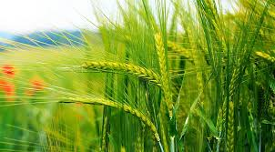
INDIAN CROP PRODUCTION ANALYSIS
Comprehensive Analysis of Crop Production Efficiency and Trends Across Indian States Using SQL
PRESENTED BY
BISWAJIT MAITY
DATA ANALYST
LEARNBAY INSTITUTE OF PVT LTD

Slide 2
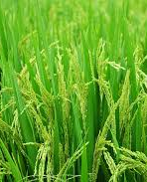
PROJECT PROBLEM SATEMENT
The agricultural sector plays a critical role in the Indian economy, contributing significantly to GDP and providing livelihoods for millions. However, assessing the efficiency of crop production is essential to understand which crops yield the best results, identify patterns in production growth, and highlight areas for improvement.

Slide 3
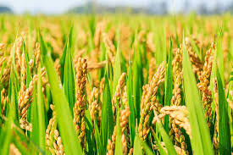
PROJECT GOAL:-
The goal of this project is to analyze crop production data from various states and districts in India over multiple years to:
Determine which crops are the most efficient in terms of production yield (production per unit area).
Calculate year-over-year percentage growth in crop production for each state and crop.
Identify the top N states with the highest average crop yield over multiple years.
Assess the variance in crop production across different states and crops to determine stability and consistency.
Identify states with the largest increase in cultivated area for a specific crop between two years.

Slide 4
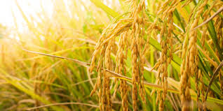
PROJECT OVERVIEW
This project will utilize a dataset containing crop production data across different Indian states, districts, and years to derive insights using SQL. The analysis will focus on calculating key performance indicators such as crop yield, production growth, average yield, and area variance. Specific SQL queries will be developed to address the following:
Crop Yield Calculation:
2. Year-over-Year Growth Analysis:
3. Top N States by Average Yield:
4. Variance in Production:
5. Cultivated Area Changes:

Slide 5

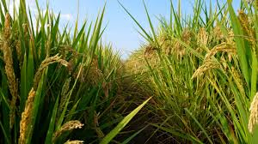
Data Description.
State Name: Name of the state where the crop was grown.
District Name: District within the state.
Crop Year: Year of crop production.
Season: Season in which the crop was grown (e.g., Kharif, Whole Year).
Crop: Type of crop produced.
Area: The area (presumably in hectares) used for cultivation.
Production: The crop production output (presumably in metric tons).
TOOLS USED

Slide 6
Insights I need to find in SQL
Calculate crop yield (production per unit area) to assess which crops are the most efficient in production.
calculates the year-over-year percentage growth in crop production for each state and crop.
calculates each state's average yield (production per area) and identifies the top N states with the highest average yield over multiple years.
calculates the variance in production across different crops and states. (tip: use VAR function).
Identifies states that have the largest increase in cultivated area for a specific crop between two years

Slide 7
CREATE DATABASE AND LOAD THE FILE IN MICROSOFT SQL SERVER
create database learn bay;
select * from
Crop _ prod _ study;

Slide 8
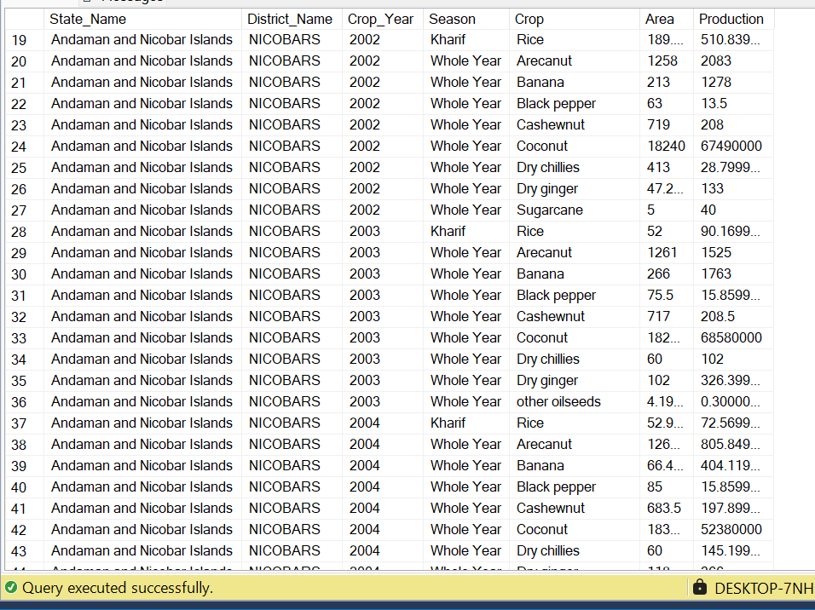

Slide 9
Calculate crop yield (production per unit area) to assess which crops are the most efficient in production.
SELECT
Crop,
State _ Name,
Crop _ Year,
SUM(Production) / NULLIF(SUM(Area), 0) AS Crop _ Yield
FROM Crop _ prod _ study
GROUP BY Crop, State _ Name, Crop _ Year
ORDER BY Crop _ Yield DESC;

Slide 10
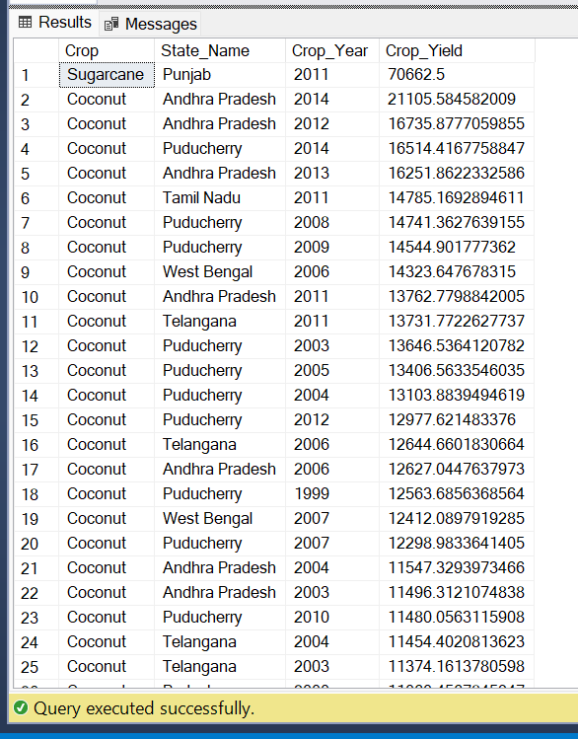
ANSWER:-

Slide 11
2.calculates the year-over-year percentage growth in crop production for each state and crop.
SELECT
State _ Name,
Crop,
crop _ Year,
Production,
LAG(Production) OVER (PARTITION BY State _ Name, Crop ORDER BY crop _ Year) AS Previous _ Year _ Production,
((Production - LAG(Production) OVER (PARTITION BY
State _ Name, Crop ORDER BY crop _ Year)) /
NULLIF(LAG(Production) OVER (PARTITION BY
State _ Name, Crop ORDER BY crop _ Year), 0)) * 100 AS
Year _ Over _ Year _ Growth
FROM Crop _ prod _ study
ORDER BY State _ Name, Crop, crop _ Year;

Slide 12
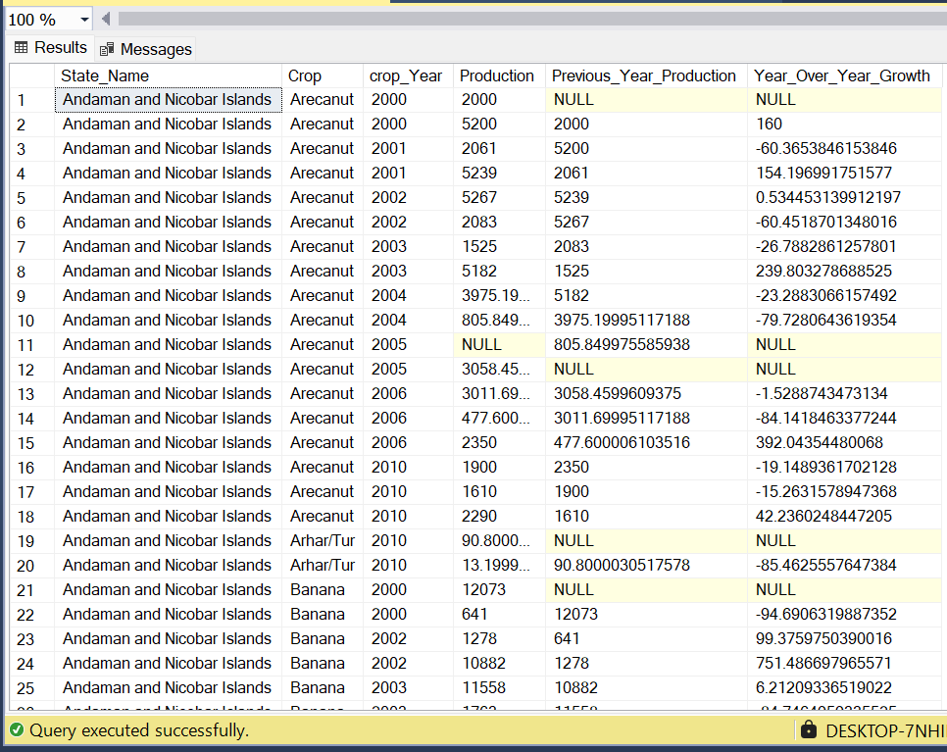
ANSWER

Slide 13
3. calculates each state's average yield (production per area) and identifies the top N states with the highest average yield over multiple years.
SELECT TOP 10
State _ Name,
AVG(Production / NULLIF(Area, 0)) AS Average _Yield
FROM Crop _ prod _study
GROUP BY State _ Name
ORDER BY Average _ Yield DESC;

Slide 14
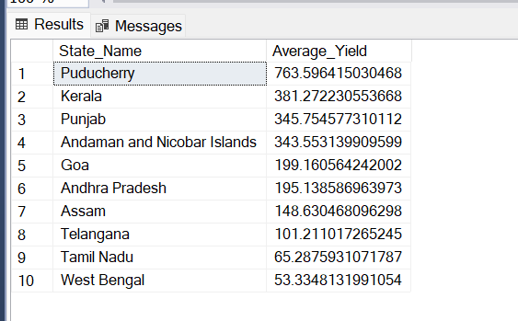
ANSWER:-

Slide 15
4.calculates the variance in production across different crops and states.
SELECT
Crop,
State _ name,
VAR(Production) AS Production _ Variance
FROM Crop _ prod _ study
GROUP BY Crop, State _ Name
ORDER BY Production _ Variance DESC;

Slide 16
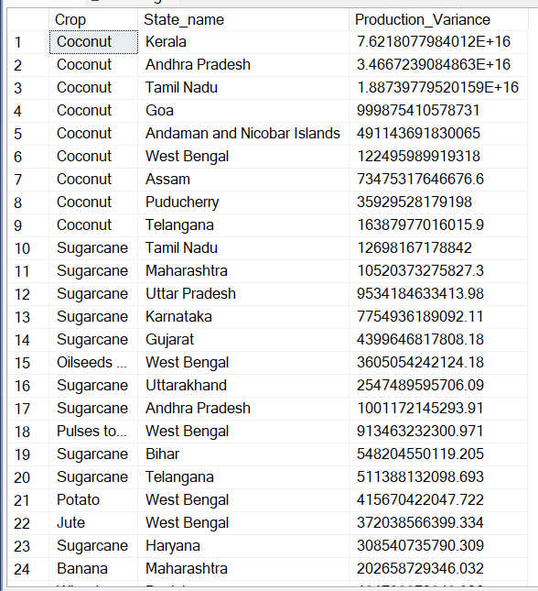
ANSWER:-

Slide 17
5. Identifies states that have the largest increase in cultivated area for a specific crop between two years
SELECT
State _ name,
Crop,
crop _ Year,
Area,
(Area - LAG(Area) OVER (PARTITION BY State _ name, Crop ORDER BY crop _ Year)) AS Increase _ in _ Area
FROM Crop _ prod _ study
WHERE Crop = 'coconut'
ORDER BY Increase _ in _ Area DESC;

Slide 18
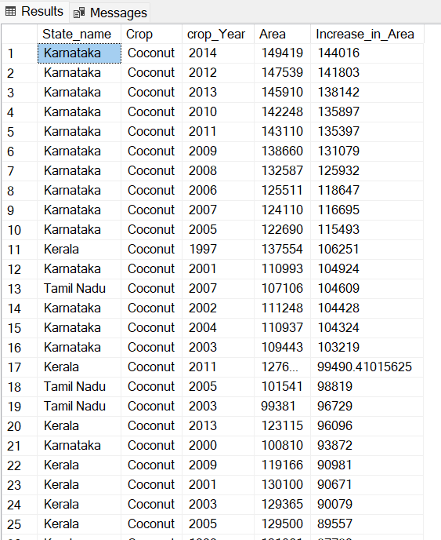
ANSWER:-

Slide 19
RECOMMENDATION
Focus on High-Yield Crops: Based on yield efficiency analysis, states should focus on cultivating high-yield crops to maximize productivity and profitability.
Monitor and Support States with High Growth: States showing the highest year-over-year production growth should receive support in terms of infrastructure, technology, and financing to sustain growth.
Stabilize Production Variances: For crops or states with high variance, stabilizing factors should be introduced, such as better irrigation techniques, pest control, and climate-resilient crop varieties.
Targeted Expansion: For states with the largest increase in cultivated areas, further analysis should be conducted to determine if this expansion is sustainable and aligned with market demand.

Slide 20

THANK YOU

